Slide 1
Application of Graph Signal Processing Tools for fMRI Signal Analysis

Slide 2
Data Points
257 Timestamps data
Data point for every 2 seconds
Time-series data obtained for every voxel in the whole brain system
Number of voxels per regions is given in .mat files
NxM matrix with N being timestamps, M being number of voxels in that region

Slide 3
Graph Description
Approach 1
Take voxels of one region and find a function which can map all these time series data to one time series vector.
Nodes are the regions
Edges are learnt over the graph
Edge weights are also learnt over the graph using graph learning techniques
Approach 2
Take all voxels of one region and find a function which can map all these time series data to X time series vectors making NxM into NxX matrix of data
Nodes are the newly made voxels (let’s call them sub-regions)
Edges are learnt over the graph
Edge weights are also learnt over the graph using graph learning techniques

Slide 4
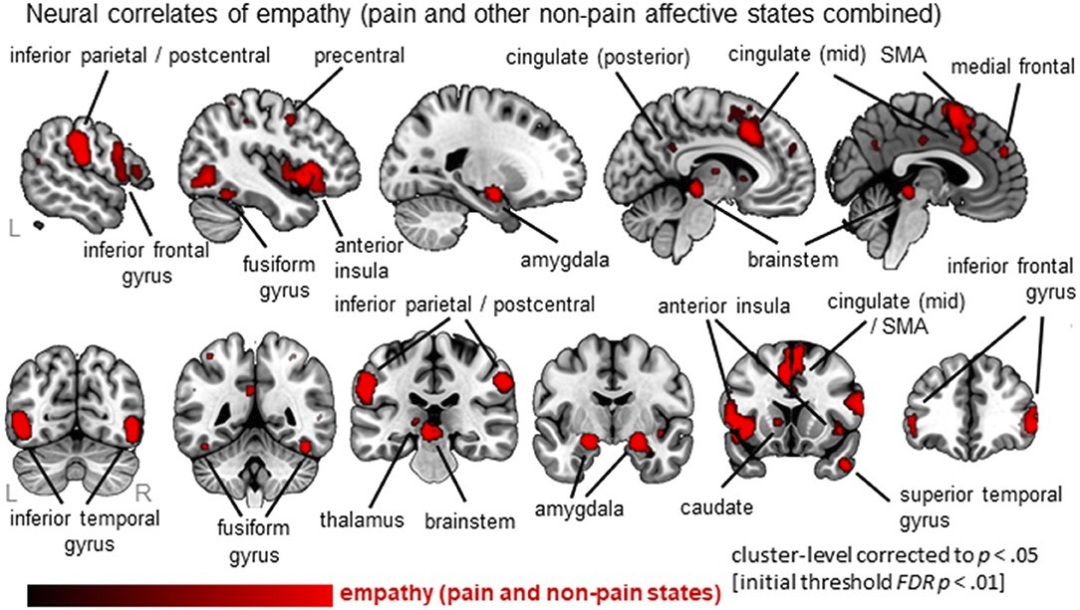
Important Regions

Slide 5
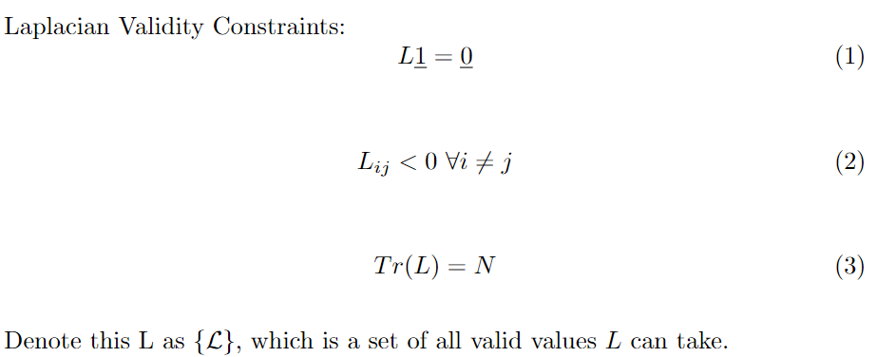
Graph Learning Constraints

Slide 6
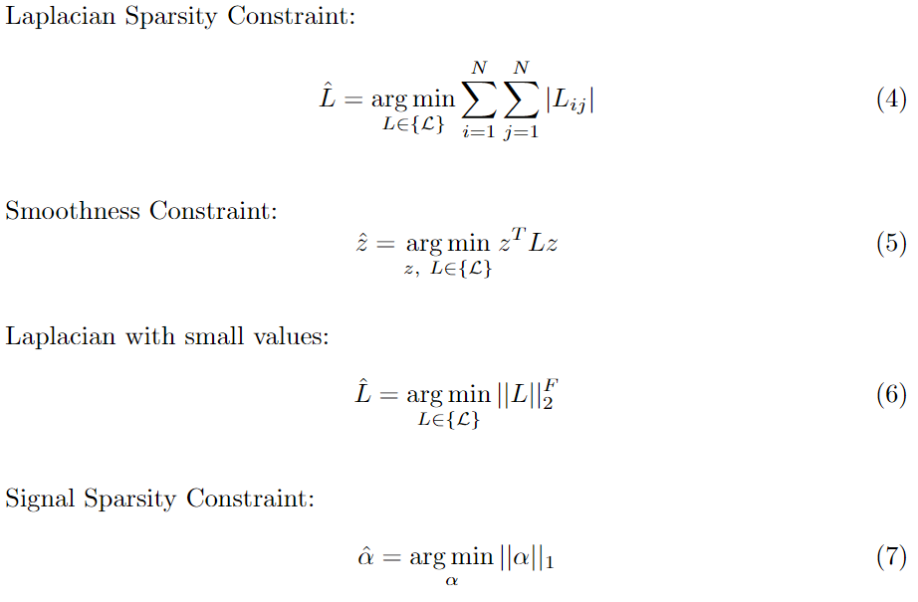

Slide 7
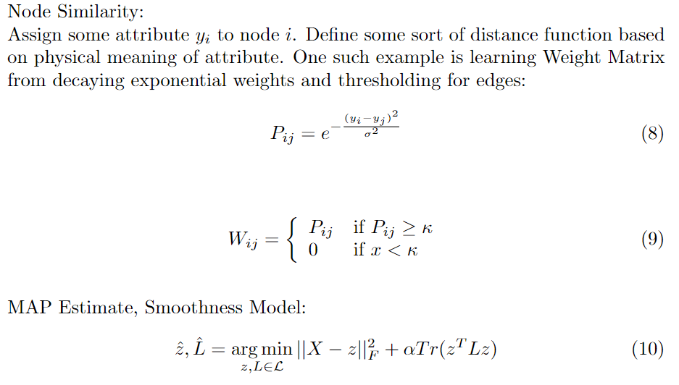
Graph Learning Methods

Slide 8
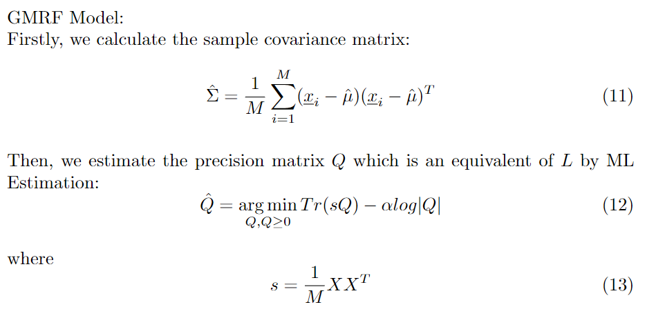

Slide 9
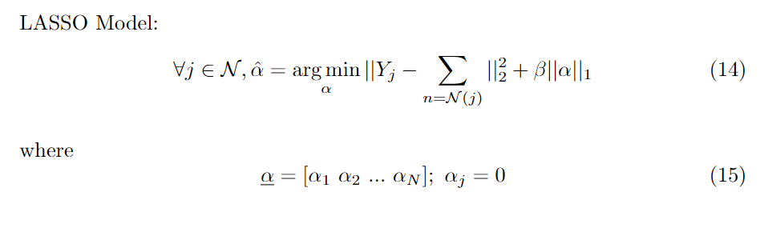

Slide 10
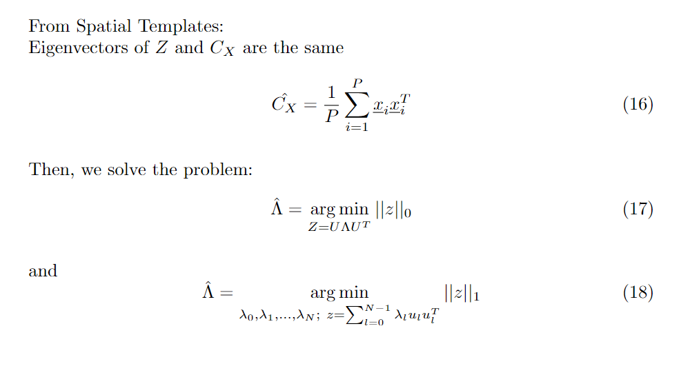

Slide 11
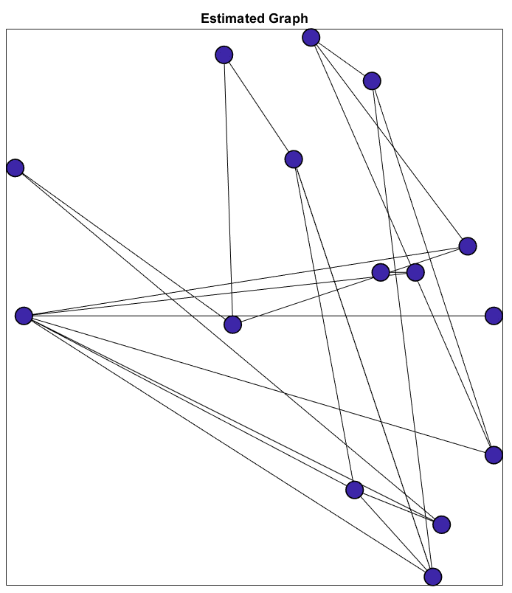
Graph Obtained using Correlation Analysis

Slide 12
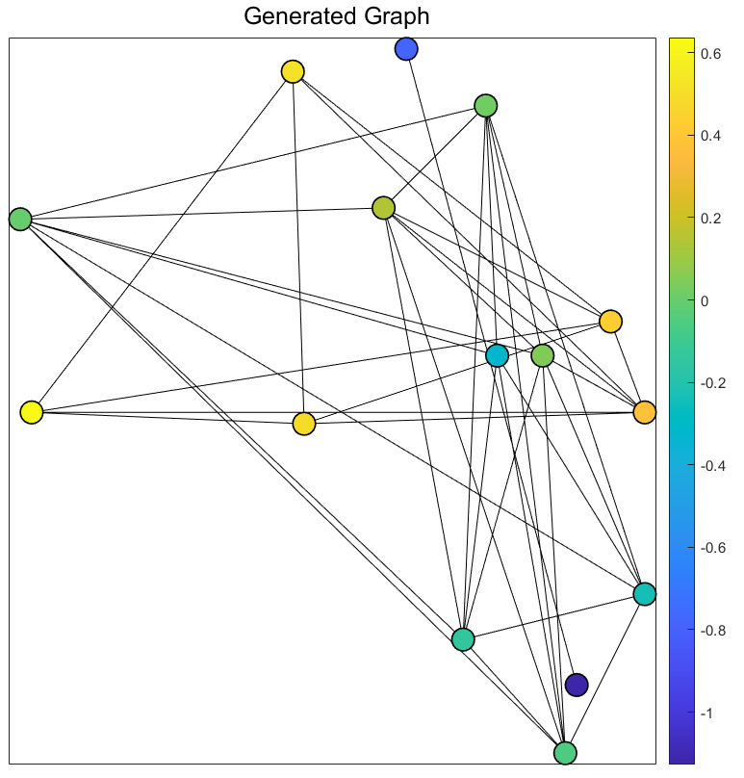
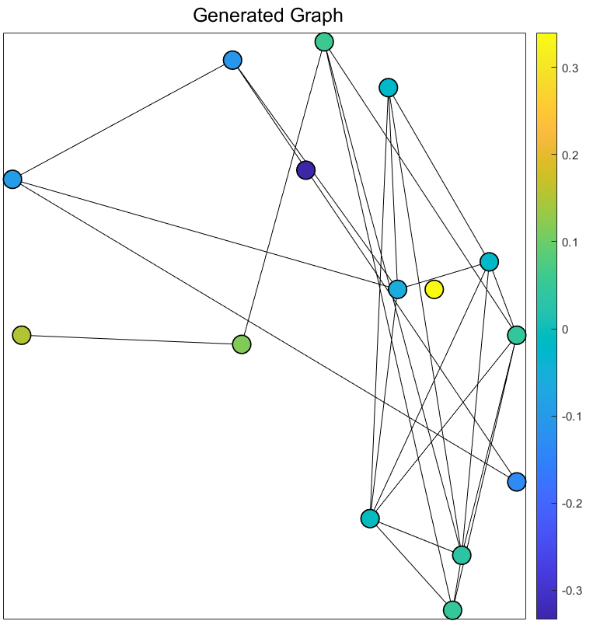
Graph Obtained using Node Similarity
TIME 2
TIME 100

Slide 13
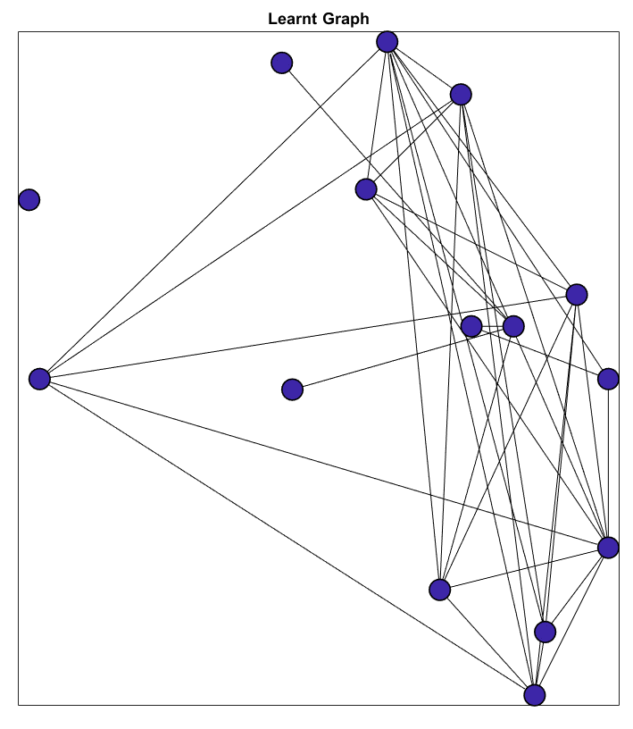
Graph Obtained using Spectral Templates

Slide 14
Ground Truth
Scale Labels obtained from the subjects
Learn the emotion for each scale given using ML
Literature review (field knowledge) of the emotion to graph correspondence

Slide 15
Interpretation from GT
Have to figure out

Slide 16
Suggestions for In-Region Voxel Combination
Simple Averaging
Max Pooling
Weighted Averaging
Using Neural Networks/Activation Networks
Using Field Knowledge on Voxel function and location

Slide 17
Questions and Doubts
Interpretation from Ground Truth
Weighted Averaging Function
Papers on general graphs for connectomes

